Slide 1
LwM2M Tutorial
Joint IETF/IRTF – OMA Meeting
Hannes Tschofenig
19th July 2019
Montreal/Canada

Slide 2
Agenda
Architecture and Protocol Stack
Messaging Layer
Data model
Securing LwM2M
Bootstrapping

Slide 3
What is IoT device management?
Key management
Service provisioning
Provisioning of access control lists
Bootstrapping
(Security)
Device Management
Remote Management
Changes to settings
Trigger actuators
Mobile Device Management
Firmware Update
Update application and system software
Apply bug fixes and add new features
Fault Management
Report errors from devices
Query status of devices
Reporting
Notify changes in sensor values
Retrieve configuration settings and device status

Slide 4
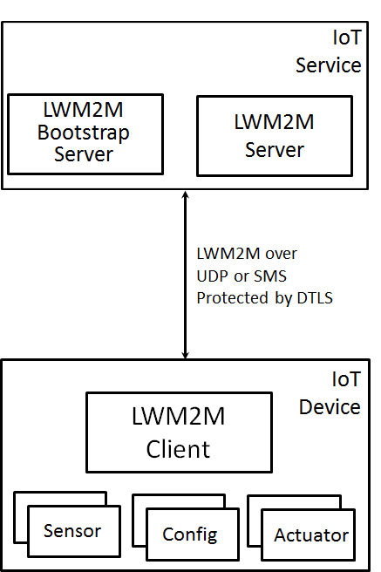
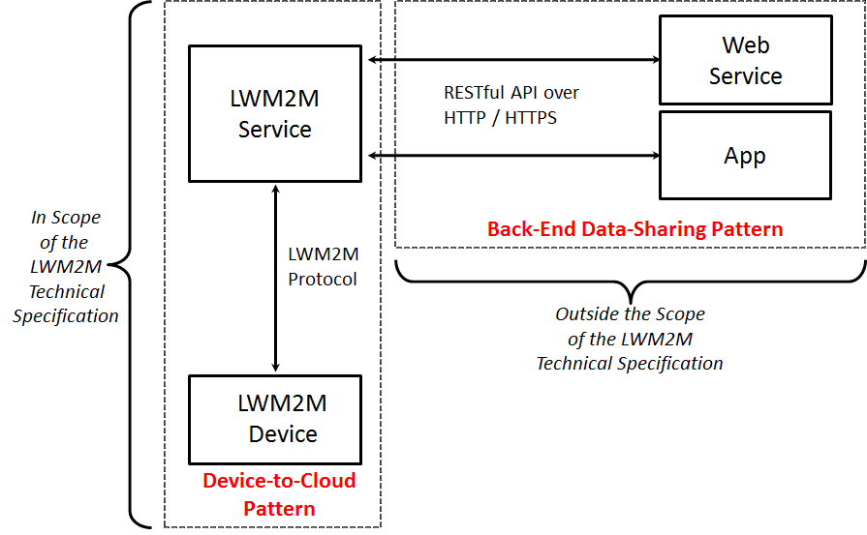
LwM2M Architecture
LwM2M protocol
For an introduction on the IoT design patterns see at http://www.internetsociety.org/doc/iot-overview

Slide 5
LwM2M v1.1.1
We recently published version 1.1.1
v1.1.1 is a bugfix release for v1.1. v1.1 was published June 2018.
Specifications are available for download here: https://www.openmobilealliance.org/release/LightweightM2M/V1_1_1-20190617-A/
Transport spec
Core spec

Slide 6
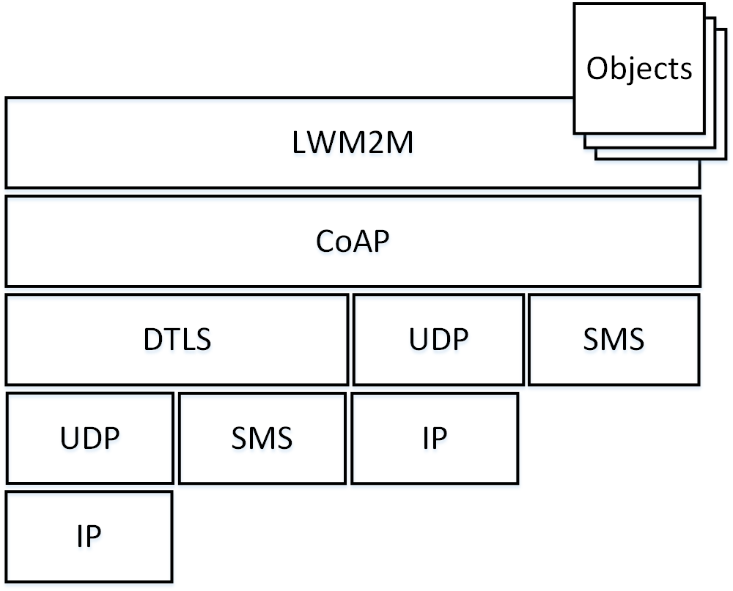
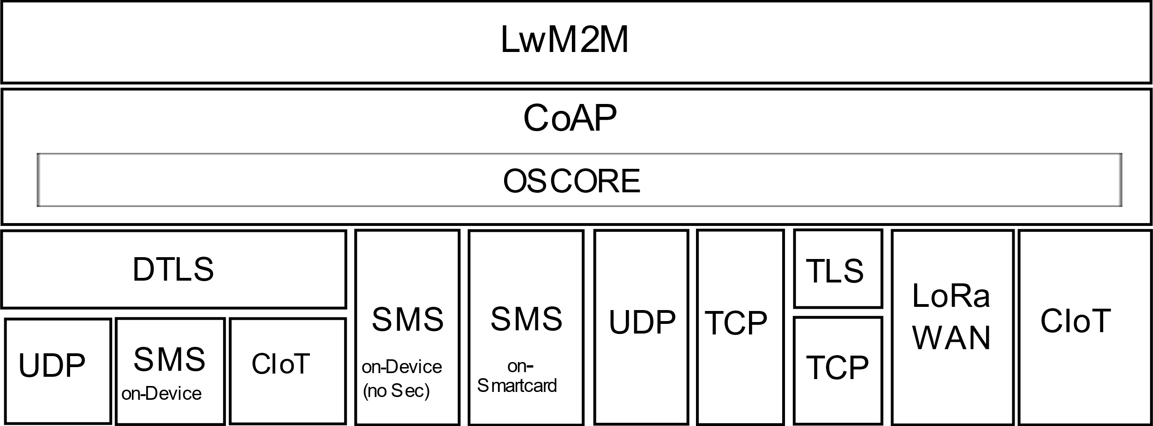
Protocol Stack
LwM2M v1.0, v1.0.1, v1.0.2
LwM2M v1.1.1

Slide 7
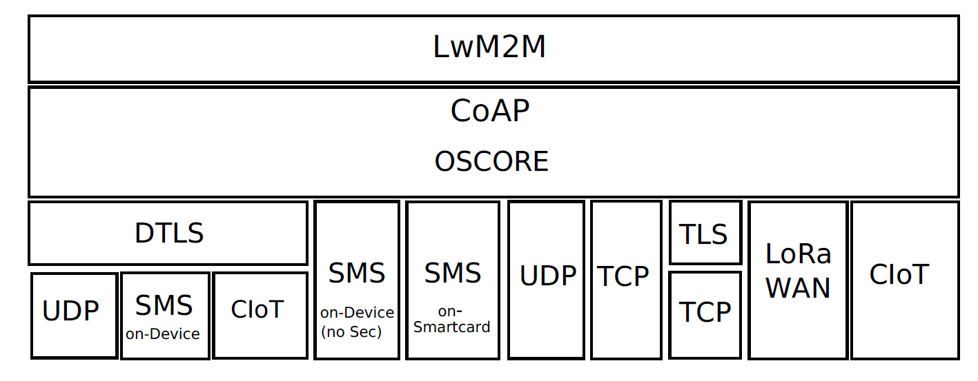
LwM2M v1.1.1
CORE
TRANSPORT
Bindings

Slide 8
Low Power WAN Support
Currently supported transports are LoRaWAN and 3GPP CIoT (NB-IoT and LTE-M).
Specification offers generic introduction to technologies and their topologies, new terminology, recommendations for timer settings, and defines transport bindings.
LoRaWAN is specified to
operate in NoSec mode (i.e., with LoRaWAN link layer security)
The LwM2M Server and the LwM2M Bootstrap-Server are LoRaWAN Application Servers.
The "register" operation has different parameter requirements. None of the parameters are mandatory. The Endpoint Client Name is not used.
CoAP transmissions were adapted to LoRaWAN usage specifics
3GPP CIoT (NB-IoT and LTE-M) follows “plain” LwM2M and allows use of DTLS. No changes to CoAP are necessary.

Slide 9
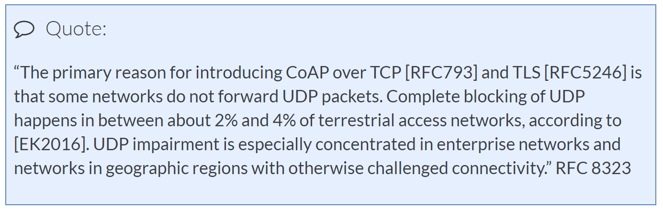
New in LwM2M v1.1: CoAP over TCP/TLS
Positive side-effects of using TCP:
Fewer keep-alive messages. According to [HomeGateway], the mean for TCP and UDP NAT binding timeouts is 386 minutes (TCP) and 160 seconds (UDP).
TCP utilizes mechanisms for congestion control and flow control that are more sophisticated than the default mechanisms provided by CoAP over UDP. CoAP block-wise transport still useful.
TCP has more overhead than UDP but there is room to tweak TCP.

Slide 10
Agenda
Architecture and Protocol Stack
Messaging Layer
Data model
Securing LwM2M
Bootstrapping
LwM2M v1.2

Slide 11
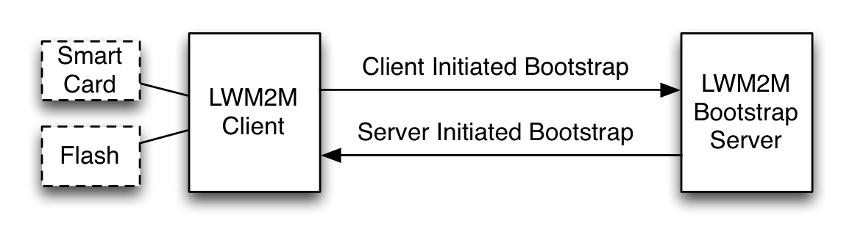
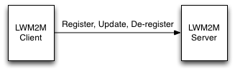
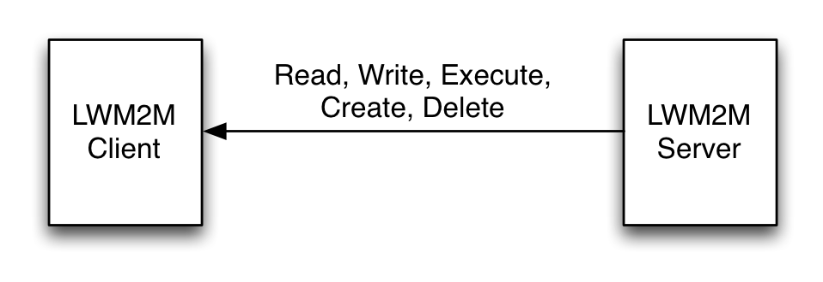
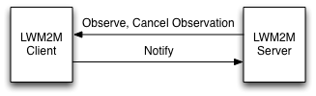
LwM2M Messaging Layer
High-level message pattern (using RESTful API) hiding details of underlying transports
Bootstrap interface
Configure credentials and ACLs for LwM2M servers
Registration interface
Informs server about “existence” of the LwM2M device and supported functionality (e.g., objects, transport bindings)
Device management & service enablement interface
Ability to access object instances and resources
Information reporting interface
Publish/subscribe interaction for observing changes in resources.
LwM2M v1.0

Slide 12
Example: Registration
CoAP POST
Confirmable, Message ID: 18947
Token: 0a0f255fe71b37a0
CoAP Ack
2.01 Created, Message ID:18947
Token: 0a0f255fe71b37a0
Opt Name: #1: Uri-Path: rd
Opt Name: #2: Content-Format: application/link-format
Opt Name: #3: Uri-Query: b=US
Opt Name: #4: Uri-Query: lwm2m=1.1
Opt Name: #5: Uri-Query: lt=600
Opt Name: #6: Uri-Query: ep=john-VirtualBox
Payload: Payload Content-Format: application/link-format
</>;rt="oma.lwm2m", </1/0>, </3/0>, </6/0>, </3303/0>
Opt Name: #1: Location-Path: rd
Opt Name: #2: Location-Path: Chohyv1bmr
Binding Modes
LwM2M Version
Lifetime
Endpoint
Client
Name
Objects and
Object Instances

Slide 13
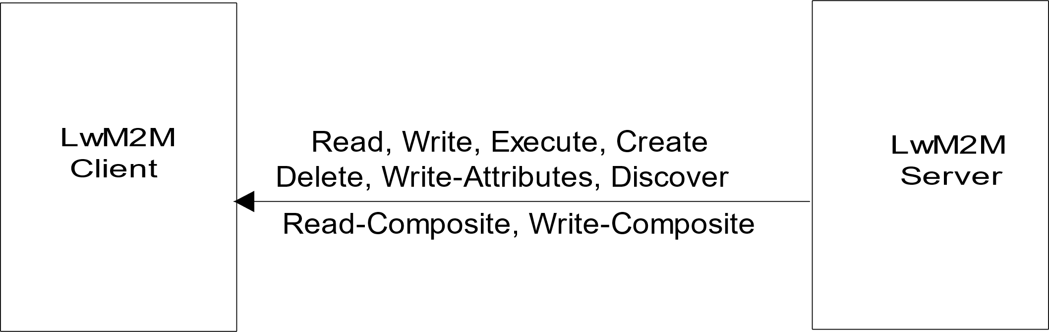
Device Management & Service Enablement Interface
v1.1.1
API Description
LwM2M v1.1 Enhancements
"Read-Composite" operation used to selectively read a number of Resources, and/or Resource Instances of different Objects in a single request.
More efficient than repeatedly sending requests to different objects/resources.
Send
The "Send" operation is used by the LwM2M Client to send data to the LwM2M Server unsolicited.

Slide 14
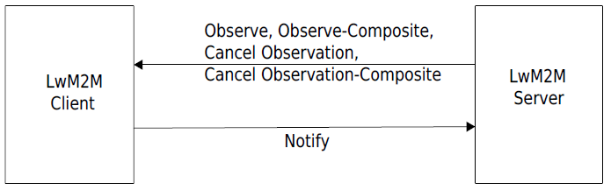
Information Reporting Interface
v1.1.1
API Description
LwM2M v1.1 Enhancements
Information reporting interface supports a publish-subscribe model. New optimizations were introduced with v1.1:
The "Observe-Composite" operation to initiate observations for a group of resources and/or resource instances across multiple object instances.
Each resource can have multiple observe conditions attached (configured using the “Write-Attribute” command).
Notes:
If any of the conditions attached to one or more resources under observation meets the notification criteria a notify will be generated by the LwM2M client, which will include the value for each of the resources listed in the "Observe-Composite" operation.
Resources that have not met the notify condition will still be included in the notification message.

Slide 15
Agenda
Architecture and Protocol Stack
Messaging Layer
Data model
Securing LwM2M
Bootstrapping
LwM2M v1.2

Slide 16
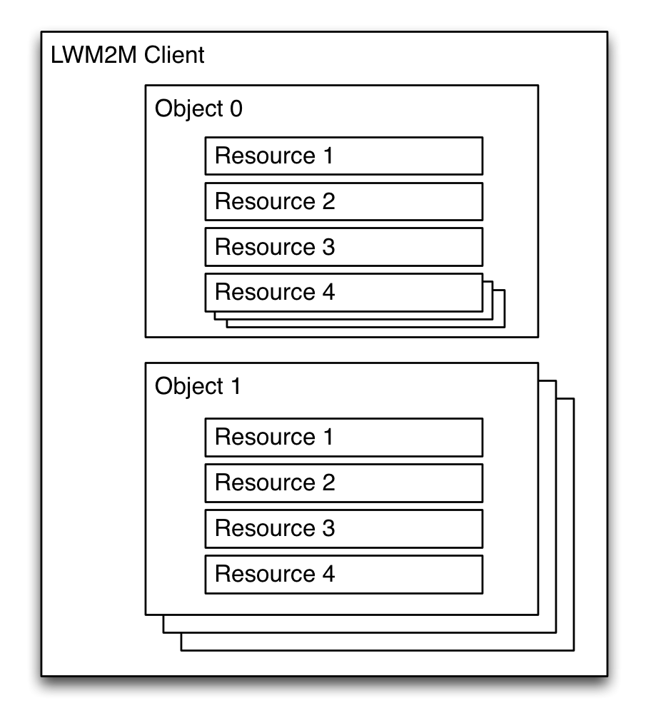
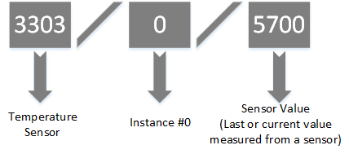
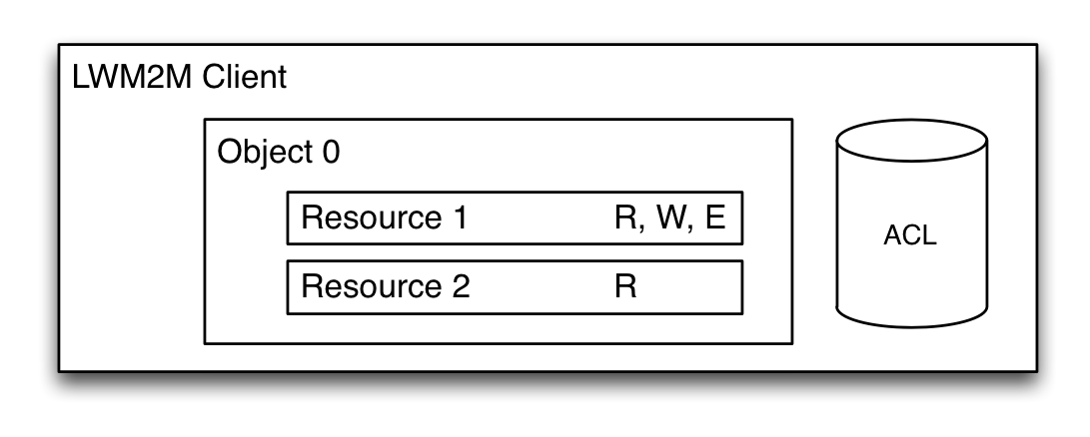
Data Model in LwM2M
Objects/Resources are accessed with simple URIs:
/{Object ID}/{Object Instance}/{Resource ID}
Example:
Notes:
An Object is a collection of Resources
A Resource is an atomic piece of information that can be
Read, Written or Executed
Resources can have multiple instances
Access control list (ACL) objects control access to objects accessed by LWM2M Servers
Objects and Resources are identified by a 16-bit Integer, instances by an 8-bit Integer

Slide 17
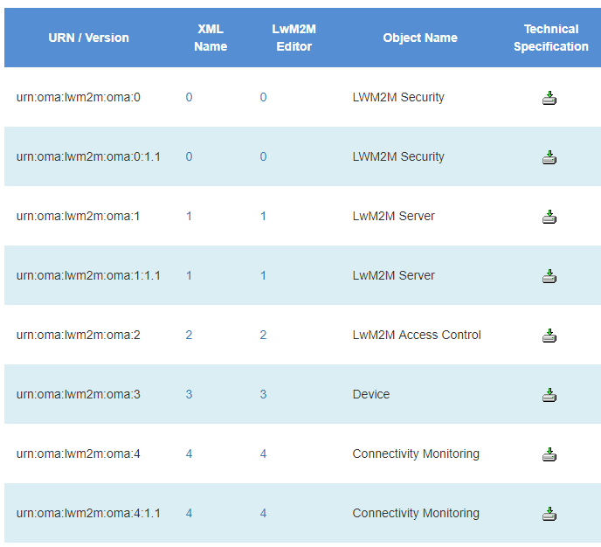
Objects Versions !?#$
Version 1.1
Concept
Idea was to avoid registering a new object id every time an object is modified
Allow object evolution independent from “enabler” specification (for those that are found in the core specification)
Object versions are signaled in the registration message
Implicit signal for objects defined in a given enabler

Slide 18
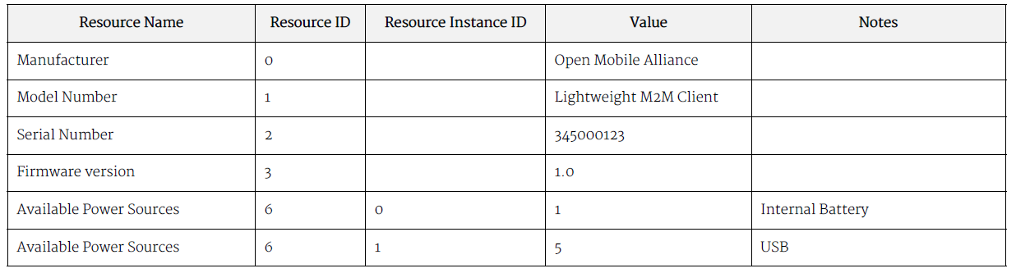
Data access in LwM2M v1.1
Extension to enable resource instance level access:
/{Object ID}/{Object Instance}/{Resource ID}/{Resource Instance}
Device Object Example

Slide 19
Objects
The LwM2M specification itself defines only eight objects.
Object Name | ID | Description
LwM2M Security | 0 | Keying material of a LwM2M Client to access a LwM2M Server/Bootstrap-Server.
LwM2M Server | 1 | Data related to a LwM2M Server.
Access Control | 2 | Information used to check whether a LwM2M Server has access to a specific object.
Device | 3 | Device related information, including device reboot and factory reset functions.
Connectivity Monitoring | 4 | Parameters related to network connectivity.
Firmware Update | 5 | Capability to update firmware
Location | 6 | Device location information
Connectivity Statistics | 7 | Information like transmit and receive counters

Slide 20



There are more objects:
OMA SpecWorks maintains a repository that contains objects and re-usable resources.
IPSO-defined objects/resources are also found in this repository (and they are currently revising).
Access to the repository is also available through an API.
It is easy to create new objects using the editor tool.

Slide 21
Example: IPSO Temperature object
Resource | ID | Operations | Type | Description
Sensor Value | 5700 | R | Float | Last or Current Measured Value from the Sensor
Min Measured Value | 5601 | R | Float | The minimum value measured by the sensor since power ON or reset
Max Measured Value | 5602 | R | Float | The maximum value measured by the sensor since power ON or reset
Min Range Value | 5603 | R | Float | The minimum value that can be measured by the sensor
Max Range Value | 5604 | R | Float | The maximum value that can be measured by the sensor
Sensor Units | 5701 | R | String | Measurement Units Definition
Reset Min and Max Measured Values | 5605 | E | String | Reset the Min and Max Measured Values to Current Value
Data
Metadata
Actions
Reusable
Resources

Slide 22
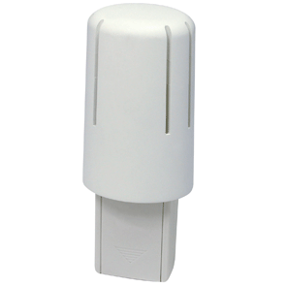

Weather Station Example Publish/Subscribe
Simple observation
Observation with attributes
Device registers objects
Temperature (3303)
Humidity (3304)
Barometer (3315)
Observe temperature object
GET /3303 observe
Device reports changes to the temperature object every time it changes:
Notify 14.5C
Notify 13C
Notifications are not sent unless temperature goes below 5C
Command:
PUT /3303/0/5700?lt=5
Lt (lower than) 5C

Slide 23
Weather Station Example Energy Efficiency
Assume that weather station is battery powered and “sleeps” most of the time.
Functionality in LwM2M, called Queue Mode, to support such devices.
Allows device to indicate that it is dormant. Server queues requests that arrive in the meanwhile.
Device uses informs the LwM2M server once it leaves power saving mode and ready to receive messages.
Server conveys messages to client within a given time window

Slide 24
Energy Efficiency - Queue Mode
(1)
(3)
Easy to interact with devices that are always connected.
For energy efficiency reasons many IoT devices sleep most of the time.
Client uses the registration refresh message to inform LwM2M server that it is awake and ready to receive messages.
Server conveys messages to client within a given time window.
(2)
(4)
(5)

Slide 25
Agenda
Architecture and Protocol Stack
Messaging Layer
Data model
Securing LwM2M
Bootstrapping

Slide 26
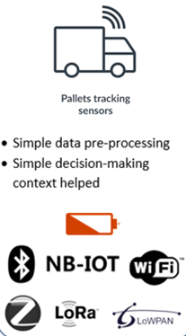
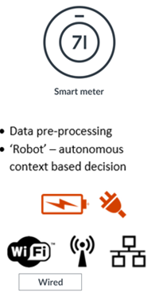
Securing LwM2M v1.0
IoT devices need communication security.
V1.0 relied on DTLS and supported three credential types:
Pre-shared secrets,
Raw public keys, and
Certificates.
Recommended algorithms:
AES-128-CBC, and AES-128-CCM / AES-128-CCM-8 (for symmetric crypto)
Elliptic Curve Cryptography (ECC) (for asymmetric crypto)
Constrained IoT Device
See webinars on TLS / DTLS concepts.
Less-constrained IoT Device
Notes:
CCM is a modern mode of operation. With CCM-8 a shorter authentication tag is used and instead of the 16 bytes the integrity check value is only 8 bytes long.

Slide 27
Securing LwM2M v1.1/v1.1.1
Uses “DTLS / TLS Profiles for IoT” (RFC 7925) with lots of recommendations.
New resource to separate the SNI from the LwM2M Server URI. This makes deployments where the certificate content and the URIs do not match practical.
Guidelines for use of certificate revocation and certificate expiry
Error handling procedures for dealing with TLS/DTLS errors.
Still offers AES-CBC but recommended not to be used.
Enhanced PKI functionality (next slide)
Added OSCORE support

Slide 28
Enhanced PKI Support
In LwM2M v1.0 the certificate in the Security Object associated with the LwM2M / Bootstrap Server had to be the certificate used by the server. This allowed only certificate pinning.
LwM2M v1.1 added support for additional PKI deployment models, including
“CA constraint” because it limits which CA can be used to issue certificates.
“Service Certificate Constraint" limits which end entity certificate can be used. Must pass PKIX validation.
“Trust Anchor Assertion” is used to specify a certificate that MUST be used as the trust anchor when validating the end entity certificate given by the server in TLS.
“Domain-Issued Certificate" limits which end entity certificate can be used. PKIX validation is not used.
Supports also raw public keys and fingerprints of certificates.

Slide 29
Agenda
Architecture and Protocol Stack
Messaging Layer
Data model
Securing LwM2M
Bootstrapping

Slide 30
Bootstrapping
A LwM2M client needs credentials to securely communicate with the LwM2M server. Configuration and access rights might also change over time.
Where does
this information come from?
LwM2M client
LwM2M server
DTLS / TLS
ACLs
Config
Device credentials
Device credentials
IoT Device
Information comes from a trusted third party and specification offers several deployment choices (including factory bootstrap, client initiated bootstrap and server initiated bootstrap).
IPSO Alliance whitepaper compares the different bootstrapping (credential management) approaches.

Slide 31
Bootstrapping
(Supported since LwM2M v1.0)
Server-generated Credentials
Client-generated Credentials
Used for symmetric keys and raw public keys.
Can also be used for certificates (with the argument that IoT devices offer a weak random number generator)
Bootstrap server generates the keying material and sends it to the client.
Communication is protected using DTLS/TLS.
Available with “Enrollment over Secure Transport (EST)” over CoAP
Private key remains on the IoT device and Certificate Signing Request is protected using DTLS/TLS.
Added value from a security point of view

Slide 32
Example: Server-Generated Certificate Bootstrapping
Bootstrap Server (B)
LwM2M Server (S)
Cert(B)
Cert(S)
DTLS using
Key Distribution
Cert(S)
Cert(C-S)
Priv(C-S)
Request
DTLS using
Cert(C-S)
Cert(S)
Response
Cert(B)
Cert(C)
Client (C)
Trust Anchor Store
Manufacturer- provided credentials
Priv(C)
Cert(C)
IoT Device
Notes:
The LwM2M bootstrapping architecture allows to provision three types of credentials, namely certificates, raw public keys, and pre-shared secrets. This slide only illustrates the details for the certificate mode, as an example.

Slide 33
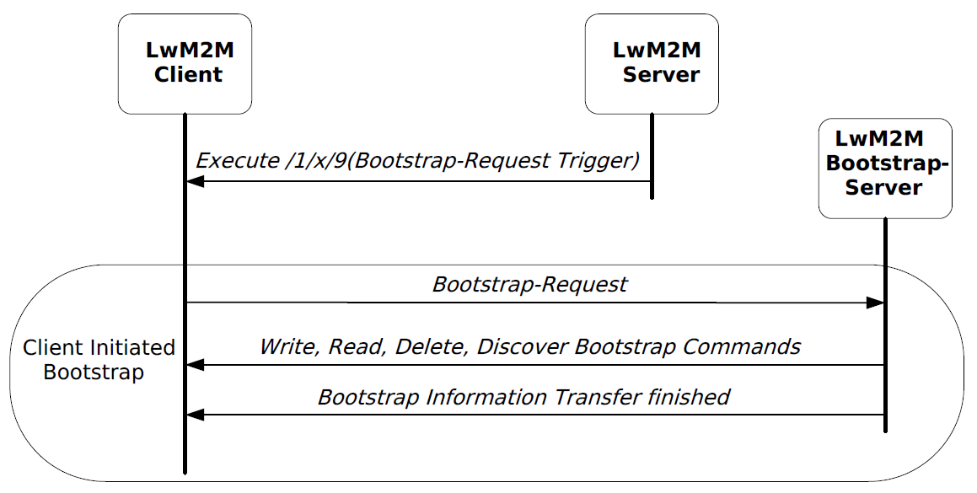
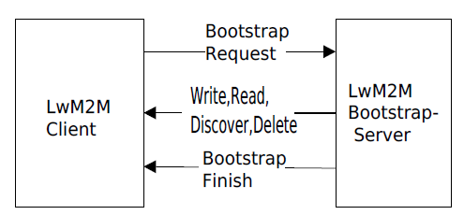
Server-Initiated Bootstrapping (LwM2M v1.1)
Server-initiated bootstrapping caused lots of problems in LwM2M v1.0
It required a role reversal and the IoT device to act as a DTLS/TLS server.
Concept only worked when the server has reachability information about the IoT device.
Does not work when the device is behind an unmanaged firewall or behind a NAT.
Replaced with the ability to allow a dedicated LwM2M server to trigger a client-initiated bootstrapping.
Added support for incremental bootstrapping.

Slide 34
Agenda
Architecture and Protocol Stack
Messaging Layer
Data model
Securing LwM2M
Bootstrapping

Slide 35
Summary
LwM2M re-uses IETF stack, including security mechanisms.
We actively contribute to the IETF standardization (e.g., SenML Fetch/Patch, CoAP over TCP/TLS).
LwM2M is implemented by OMA members and also non-members.
7 testfests already took place and next one will be in Oct. 2019 in Seoul. Spec is in development for 5+ years.
LwM2M has successfully been used over IP- and non-IP-based transports (LoRaWAN & NB-IoT).
LwM2M was designed with low-end IoT devices and constrained networks in mind. LwM2M v1.1.1 added even more performance improvements.

